Slide 1
Analyzing Marketplace Listings on Discogs
Hayley Baek
Notes:
Today, I’ve decided to take a look at the marketplace listings for Discogs.

Slide 2

What is Discogs?
Crowdsourced database and marketplace for cataloguing, buying, and selling music
LP, CD, cassette, DVD, boxset
Users negotiate prices
Global market
Notes:
To give an introduction, Discogs is a crowdsourced database and marketplace for cataloguing, buying, and selling music. Music is traded in different formats, namely vinyl LPs, CDs, and cassettes. Less commonly sold but still on the market are DVDs and boxsets. On Discogs, users can sell or buy their music by negotiate prices with each other on a global scale, handling a wide variety of currencies.

Slide 3
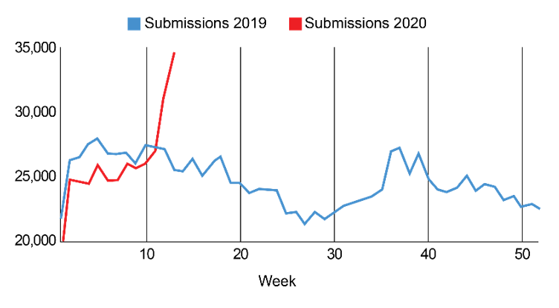
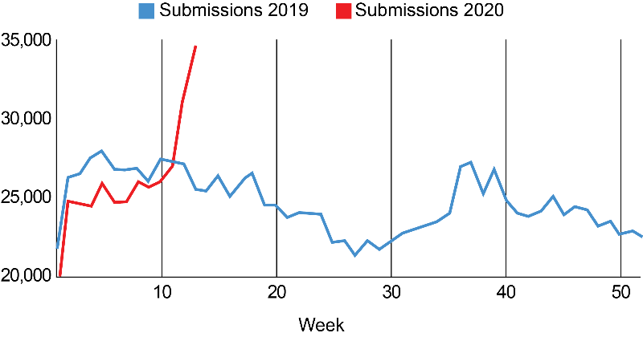
Discogs Marketplace Listings
Image: user submissions to Discogs database
Hundreds of new daily listings on the Marketplace
Set by users to sell to other users
Individual listings do not disclose
average sale price
Notes:
This image is taken from their blog under one of their posts, titled “Record week in Discogs submissions” where they announced that they had reached a record high in user submissions to its database, due to COVID-19. This clearly demonstrates that there are hundreds and thousands of new daily listings on the Marketplace. Prices are set by users to sell to other users, and typically with each individual listing, the user does not disclose the average sale price to the potential buyer.

Slide 4
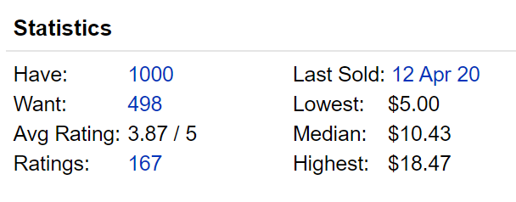
Buying Considerations
Average listing price based on past sales
Statistics on a release’s market page
Price comparisons for other releases
Personal value of a particular record
Notes:
As a buyer, what might be some considerations to take when browsing the Marketplace? Most obviously would be the average listing price based on past sales. If I saw a record listed on the Marketplace and wanted to find that record’s average price, the only way for me to compare this listing would be to look at the statistics on a release’s current market page, not on the unique listing page. This is an example of one record’s statistics table that shows the lowest, median, and highest values for which this particular version of the record has previously sold for. If I wanted to make an informed buying decision, this would be difficult to do for multiple items if this information is not readily available under each listing. Another consideration when buying is personal value, which is entirely subjective and difficult to quantify from any page on Discogs, and I’ll get to how this affects the price later.

Slide 5
Selling Considerations
Maximize profit margin
Higher value from average listing
Rare/limited edition
Mint condition
Notes:
For the seller, the most obvious best outcome would be to maximize profit margin. Looking at the average market price for a record, and selling it for a higher value so that the seller can get the most money in their pockets. In the Discogs community where negotiating for lower prices is common practice, it can be difficult for sellers to get away with selling high from their listings right off the bat. Some factors to consider to raise the value of their records is to look at rare or limited editions of records and its condition. Rare or limited edition records sell higher than average, and rare records in mint condition sell for even higher. How should these price driving factors be considered in a listing price? They are still decided entirely by the seller.

Slide 6
Data Collection
Discogs API
Application authentication
User authorization
Release IDs
Web scraping
Marketplace listings
Notes:
To collect the data, I used the Discogs API and its client to send API requests. This API required app authentication, meaning I had to declare my program as a new application and authenticate it using a set of unique client keys, and I also had to authorize myself as the Discogs user sending the requests to the API. In utilizing the API, I was able to handle the data more robustly using unique Release IDs to run better searches in the database. I also utilized some web scraping techniques to look at the marketplace listings and for any additional information that wasn’t available in the API, like entire lists of current sale prices of a given record.

Slide 7
Analyzing Marketplace Listings
Looking at 25 of the newest Marketplace listings
Comparing each item’s listed price with other listings for that item
Average and median prices calculated or found through web scraping
Notes:
When analyzing marketplace listings, I looked at 25 of the newest listings and I compared each item’s listed price with other listings for that item. For each newly listed item in the marketplace, I looked at their release ID using the API and I ran searches through its database to find other, older listings of that record. From web scraping, I was able to analyze the price for the newest listing with prices of all the old listings and read in the statistics table previously mentioned that was found on each particular release’s list of listings.

Slide 8
Data Analysis Overview
One sample t-test from new Marketplace listing against other listing prices
T-test returns calculated t-statistic and two-tailed p-value
T-statistic = how many standard deviations between two means
P-value = significance of results (likelihood of statistical difference)
P-value < 0.05
Null hypothesis = there is no significant difference between prices
Want to reject the null hypothesis (prove there is a difference)
Notes:
In analyzing the data, I utilized one sample t-tests to compare the new marketplace listings with the list of older listings for each item. T-tests return a calculated t-statistic and a two-tailed p-value, where the t-stat is how many standard deviations there are between the two means, and the p-value is the significance of the results, or the likelihood of there actually being a statistical difference. The goal here is to find a small p-value, which in this case is any value less than 0.05. Supposing that there is a null hypothesis that states that there is no significant difference between the prices, the goal is to reject the null to suggest that there is some difference between the prices, either that the newly listed item is proven to be less than or greater than the average sale price.

Slide 9

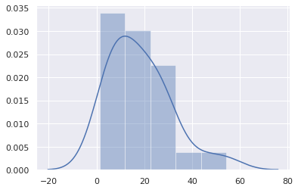
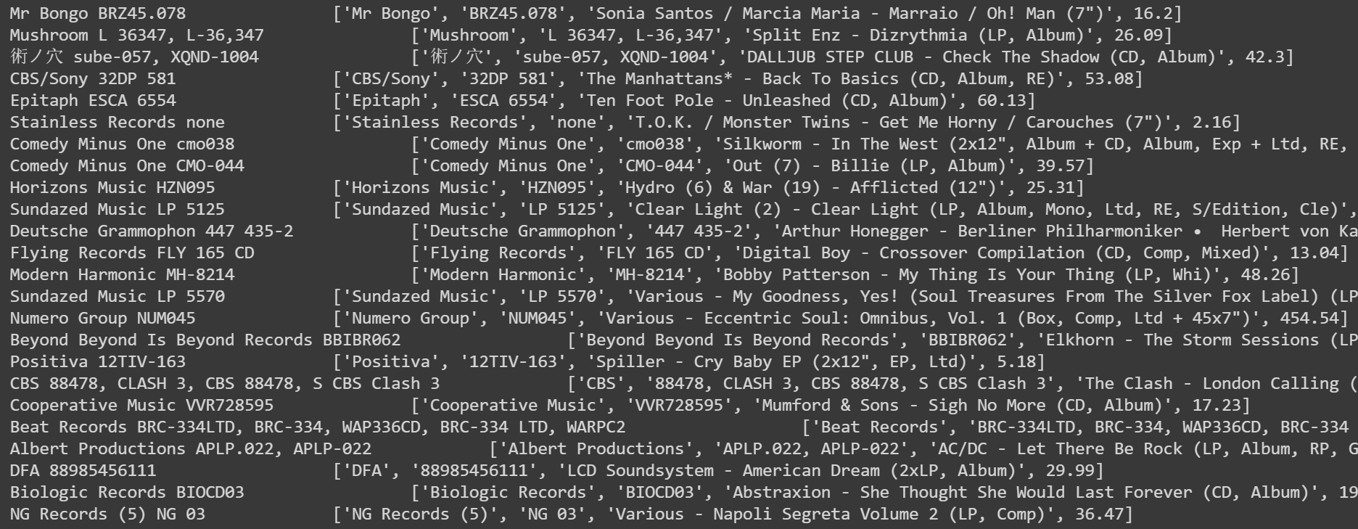
Data Gathering
25 newest listings
List of new releases scraped from Marketplace
Price distribution of listings
Notes:
This is an example of just some of the data that I’ve gathered from the marketplace. In the left image, I have on the left column the record label and its category number as keywords to run searches for, and on the right column is a list of the data I’ve gathered which includes the title of that record and its listed price. The distribution plot on the right is the distribution of prices for this set of listings. They fall from anywhere between $0-$60.

Slide 10
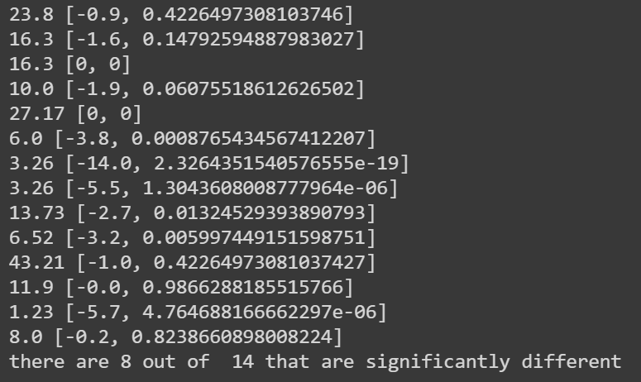
Results
This is the result of running the t-tests on these listings
Smaller volume of results returned—why?
Very large p-values suggest failure of rejection of null hypothesis
Notes:
These are the results of running the t-tests on the listings, which came out significantly fewer than what was entered in the t-test function. After looking at and reworking the code for a long time, I still wasn’t able to explain why the number of results of running the t-tests is so different from what was entered, but regardless this is the data that I was given to work with. The values on the left are the sale price of the new listings, and the 2 item lists are the results from the t-tests. The first item in the list is the t-value, the number of standard deviations from the norm that the item’s price falls from the average, and the p-value, the statistical significance of the t-test. In this particular run of t-test analyses, there are 8 out of 14 returned listings that are in fact statistically different from their average listings. What does it mean that on average, half of the listings are different and the other half is not?

Slide 11
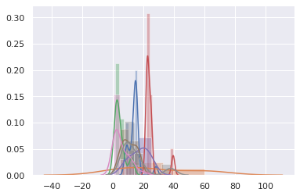
Results (cont.)
Distribution of other listings
Most of the data gathered around $0-$30 range
Notes:
This is a distribution of the prices of the new releases on the Marketplace. As you can see, most of the records are priced anywhere from $0-$30. While there weren’t too many new listings that were that expensive, most of them would probably fall under the $15-$30 range. Knowing that half of the new marketplace listings are significantly different from their average listings, what can be said about this distribution of other listings on the market? The variation between them is significant enough to indicate that there is a close range of average prices and that hundreds of new listings being added daily slowly widens the range of prices that buyers are willing to pay for a record.

Slide 12
Takeaway
Other factors to consider buying records besides average market price
Factors quantifiable?
Informed buying choices entirely personal
Music as a commodity
Notes:
The takeaway here is that there are definitely other factors to consider in buying records than just the average market price. I wasn’t able to show any general trend of average listing prices being a strong factor in buying a record. I didn’t look at the differences between mint condition vs very good condition because the intuition is already there that mint condition records sell for higher than very good condition records. I also didn’t consider looking at a record’s value between different physical copies because as a music collector myself that there are clear differences between different physical presses and I thought to compare red apples to green apples isn’t so bad as comparing apples to oranges, but it was still an unfair comparison. Are these factors like condition and differences between physical copies quantifiable? I thought it wasn’t, and going back to my earlier note on buying considerations being entirely personal, that is a totally separate and objectively unquantifiable factor when selling a record, is how much someone else will like the music. Music generally as a commodity is tricky, and I ultimately was not able to show that people necessarily lose or gain money from selling records, just that there is slowly a growing trend of paying a wider range of prices for records.

Slide 13
Sources
Google Colab Notebook: https://colab.research.google.com/drive/1CLJor-zSQECk4e4B83V84PTI8Nm9A8M-?usp=sharing
Discogs API: https://www.discogs.com/developers/
Discogs.com: https://www.discogs.com/
Record submissions blogpost image: https://blog.discogs.com/en/record-week-discogs-submissions/
Notes:
These are the sources I’ve used throughout this presentation, including a link to the Colab notebook that I used to gather and analyze the data from the Discogs database. Thank you for listening.

